Slide 1
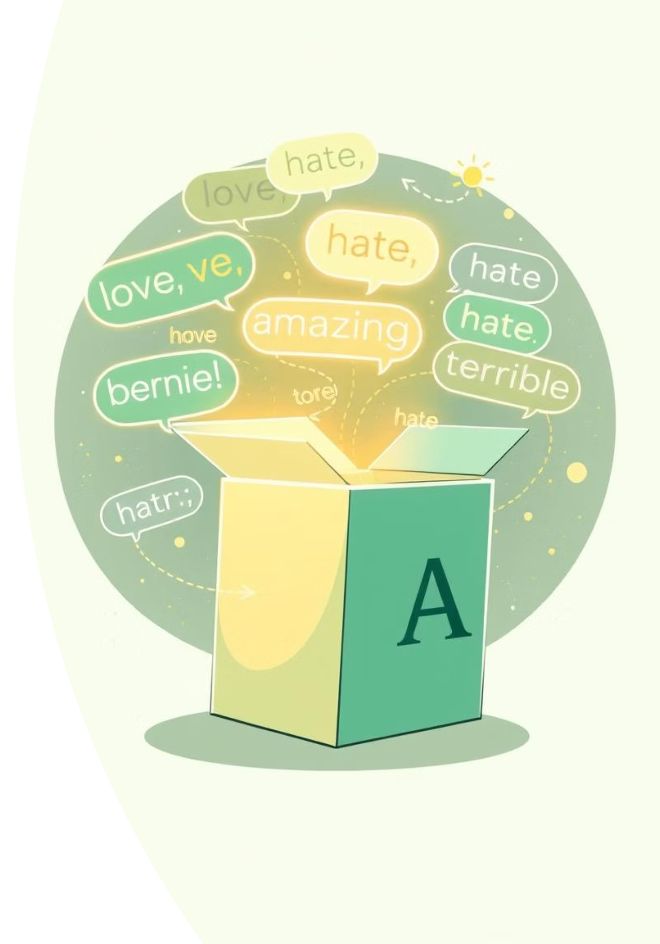
Amazon Product Review Sentiment Analysis

Slide 2

Problem Statement: Unlocking Customer Insights
Amazon product reviews contain a wealth of unstructured data. Extracting meaningful sentiment at scale is crucial for businesses to understand customer satisfaction, identify product strengths and weaknesses, and inform strategic decisions.

Slide 3
Introduction: Bridging the Gap with NLP
This project demonstrates a practical application of Natural Language Processing (NLP) for sentiment analysis on a dataset of Amazon product reviews. We compare traditional lexicon-based methods with transformer-based models to evaluate their effectiveness.
Lexicon-Based Approach
Transformer Models
Leverages predefined dictionaries of words with associated sentiment scores.
Utilizes deep learning architectures pre-trained on vast text corpora for contextual understanding.

Slide 4
Existing System: Baseline Sentiment Analysis
Initially, we relied on a basic sentiment analysis approach. This method, while simple to implement, provided a preliminary understanding but often lacked the nuance required for complex review data.
Manual Review Tagging
Keyword Spotting
Time-consuming
Identifies explicit positive/negative words
Subject to human bias
Fails to capture sarcasm or subtle sentiment
Limited scalability
Low accuracy on diverse language

Slide 5





Proposed System: Advanced NLP Pipeline
Our proposed system integrates a robust NLP pipeline, combining data preprocessing, feature engineering, and advanced machine learning models for more accurate sentiment prediction.
Preprocessing
Evaluation & Deployment
Data Ingestion
Model Training

Slide 6
Software & Hardware Requirements
Software Stack
Hardware Considerations
Python 3.x: Core programming language.
Processor: Multi-core CPU (Intel i7/AMD Ryzen 7 or higher recommended).
Pandas: Data manipulation and analysis.
NLTK: Text preprocessing and VADER sentiment analysis.
RAM: At least 16GB, 32GB or more for larger datasets.
GPU (Optional but Recommended): NVIDIA GPU with CUDA support for faster transformer model inference.
Hugging Face Transformers: Access to pre-trained RoBERTa model.
Storage: SSD for faster data loading and processing.
Matplotlib & Seaborn: Data visualization.
tqdm: Progress bars for iterations.

Slide 7



Modules Involved in the Project
Data Ingestion & Preprocessing
Sentiment Model Application
Results Aggregation & Visualization
Loading raw CSV data, initial cleaning, and tokenization.
Applying VADER and RoBERTa models to calculate sentiment scores.
Consolidating scores and generating insightful plots for analysis.

Slide 8
Machine Learning Models Utilized
We employed two distinct machine learning models for sentiment analysis, allowing for a comparative evaluation of their performance.
VADER (Valence Aware Dictionary and sEntiment Reasoner)
RoBERTa (Robustly Optimized BERT Pretraining Approach)
A lexicon and rule-based sentiment analysis tool specifically attuned to sentiments expressed in social media. It provides four scores: positive, negative, neutral, and a compound score.
A transformer-based model optimized from BERT, excelling at understanding context and complex linguistic patterns. We used a version fine-tuned for general sentiment analysis.
Quick and efficient.
Captures contextual sentiment.
Good for general-purpose sentiment.
Higher accuracy on complex text.
Less effective on nuanced or domain-specific language.
Computationally more intensive.

Slide 9
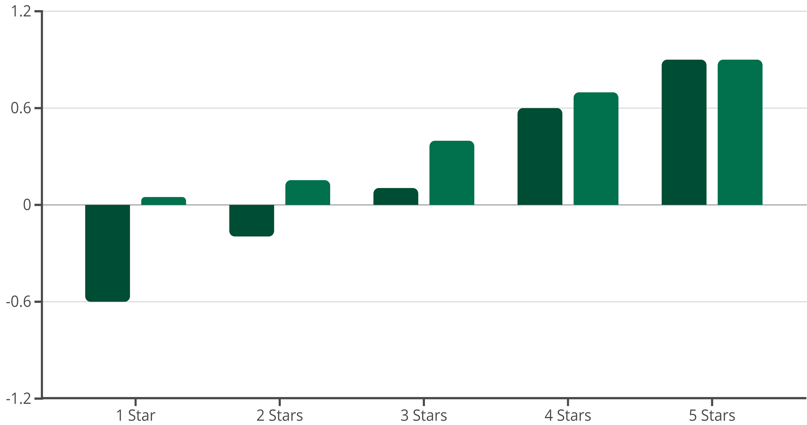
Testing & Output: Code in Action
The analysis involved processing 10,000 Amazon reviews. We compared VADER's and RoBERTa's sentiment predictions against the actual star ratings.
VADER Compound
RoBERTa Positive
Results show RoBERTa's scores align more closely with star ratings, especially for 3 and 4-star reviews, demonstrating better nuance.

Slide 10
Conclusion & Future Work
This project successfully implemented and compared two NLP sentiment analysis models, VADER and RoBERTa, on Amazon product reviews.
Key Takeaways
Next Steps
RoBERTa demonstrates superior contextual understanding over VADER.
Explore domain-specific fine-tuning of transformer models.
Sentiment analysis provides actionable insights for product improvement.
Integrate aspect-based sentiment analysis for granular insights.
Scalable approach for large datasets.
Deploy models for real-time review processing.

